Slide 1
Predicting Fuel Transition & EV Adoption

Slide 2
Introduction
Our Goal:
Use machine learning models to predict EV adoption patterns (e.g., EV registrations)
Our Focus:
Examining a variety of models (e.g., Linear Regression, Random Forest, Neural Networks)
Demonstrate an exploratory and comparative approach to our goal
Emphasizing interpretation of results to drive actionable insights, instead of optimizing and perfecting models
Importance:
Understanding EV adoption helps policymakers, manufacturers, and infrastructure planners optimize strategies to support a sustainable future

Slide 3
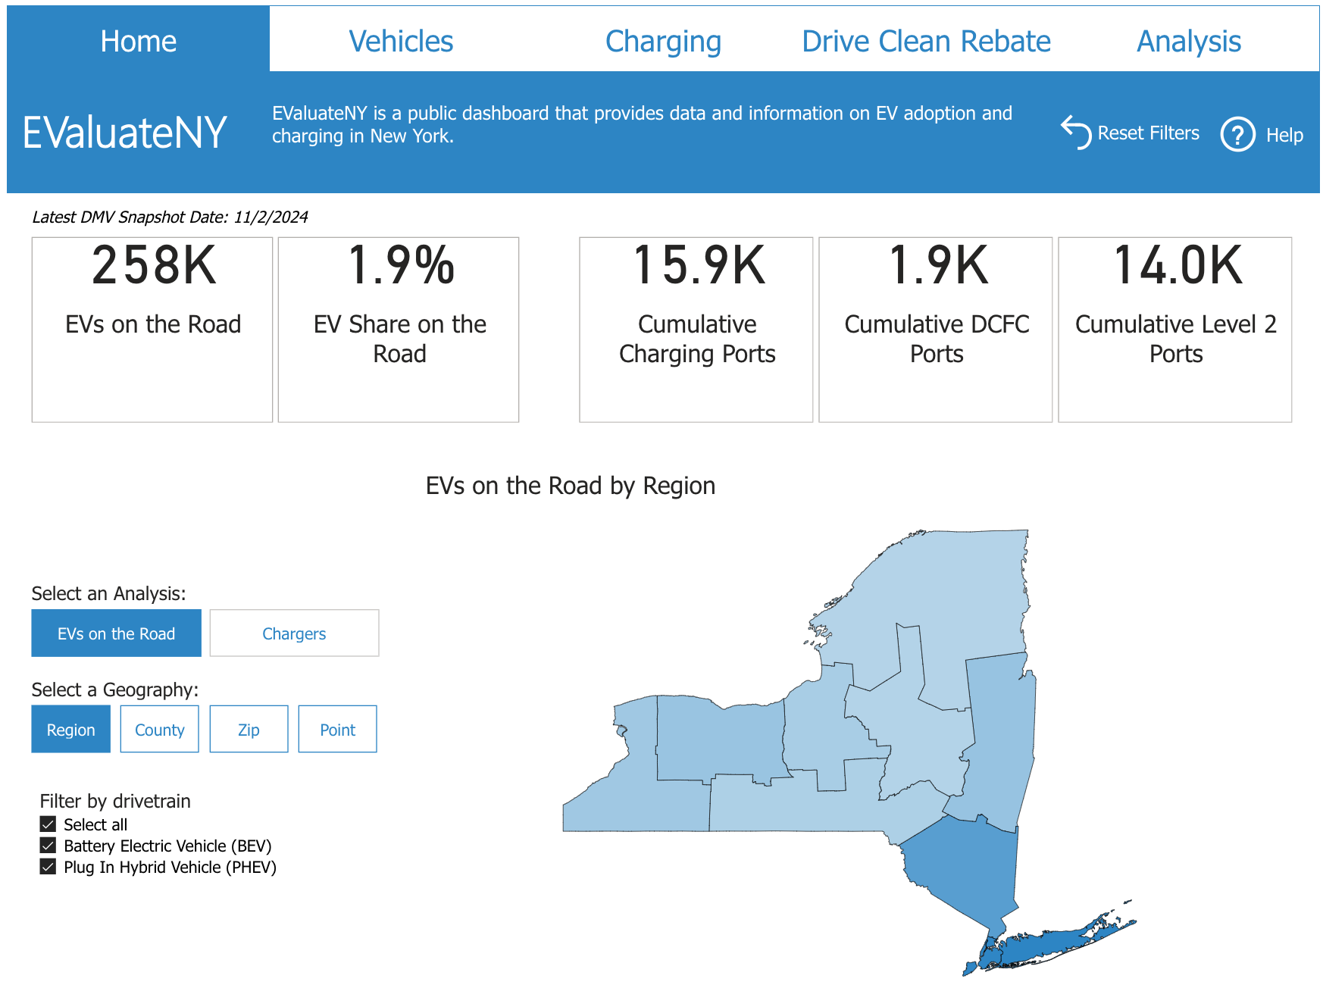
Data Overview
Primary Dataset:
Source: New York State transportation fuel data.
Key Features: Regional economic and fuel-related factors.
Augmented Data:
Added key EV-related metrics:
EV registrations ¹
EV rebate distributions & amounts ²
EV charging infrastructure (e.g., stations, connector types) ³

Slide 4
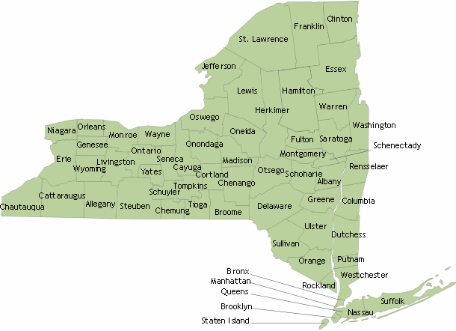

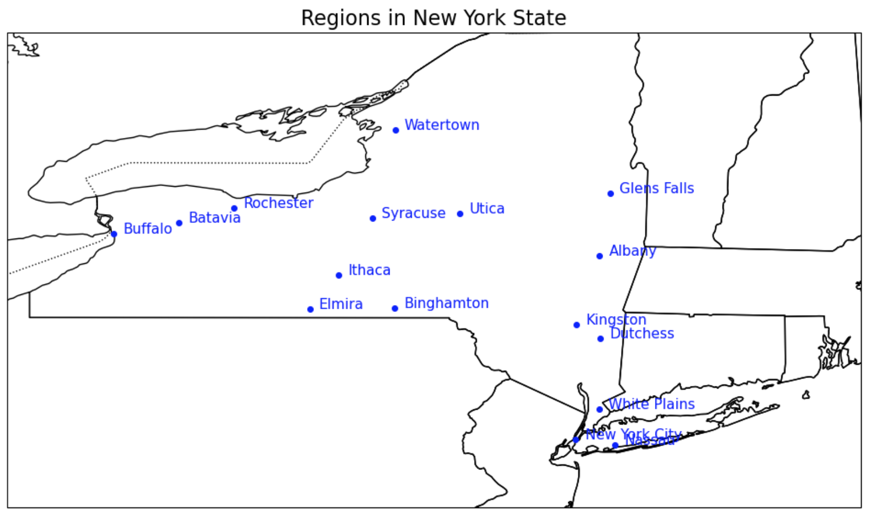
Data Processing
Regional Aggregation:
Grouped data by region (e.g., Albany, Syracuse), where each region becomes a single row.
Feature Engineering:
Created new columns for metrics like:
Region Gas Cost ($/gal)
Region Diesel Cost ($/gal)
Registration Count
stations_opened_count
avg_ghg_reductions
avg_petroleum_reductions
Handling Missing Data:
Addressed gaps in regional metrics via exclusion.

Slide 5
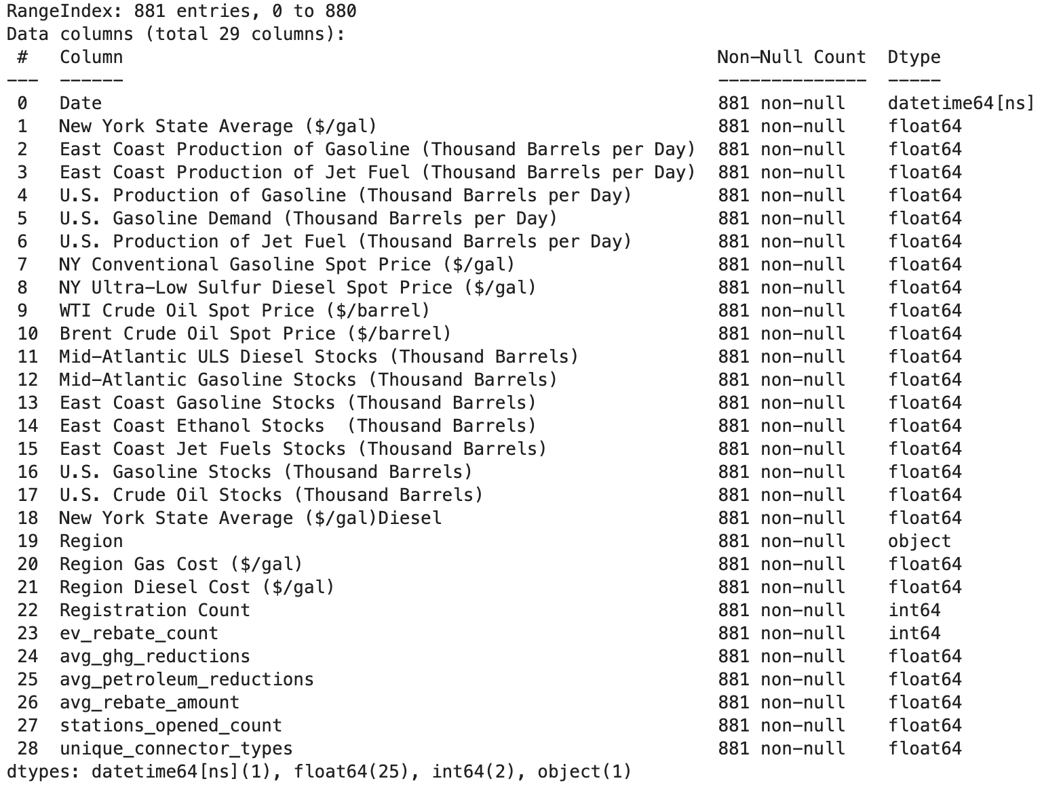
Dataset (Post Processing)

Slide 6
Predictive Modeling
Approach:
Predict EV adoption (number of EV registrations) using economic and policy factors as input features.
Models Used:
Linear Regression: Baseline for prediction.
Decision Tree: Captures non-linear relationships between features.
Random Forest: Combines multiple trees for better accuracy and generalization.
Neural Networks: Explores deeper patterns using multi-layer perceptrons.
Evaluation Metrics:
Mean Absolute Error (MAE)
Mean Squared Error (MSE)
R² Score

Slide 7
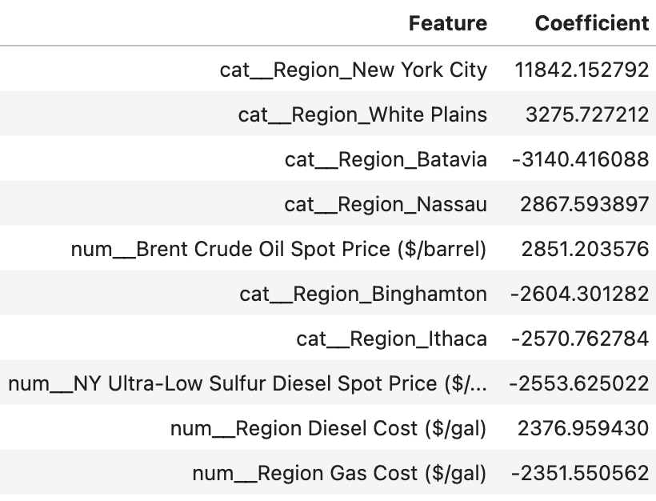
Linear Regression
Linear regression was employed as a baseline predictive model to evaluate relationships between features and EV registrations
Provides interpretable coefficients for actionable insights
Key Assumptions: Linearity, independence, homoscedasticity, normality, no multicollinearity, exogeneity, no outliers
Predictions may be inaccurate; coefficients may not reflect true relationships
Performance:
Mean Absolute Error (MAE): 1159.13
Mean Squared Error (MSE): 4462935.35
R² Score: 0.85

Slide 8
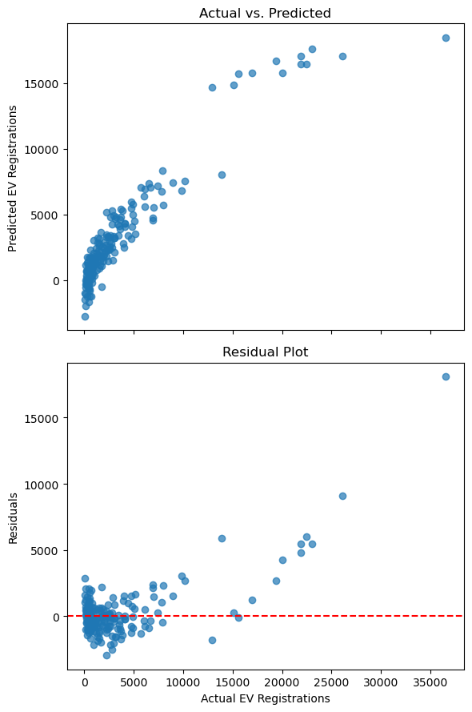
Linear Regression
The model seems to systematically underpredict for higher actual values
Likely due to a non-linear relationship our model cannot capture
The residuals are clustered near zero for smaller values but increase for larger values (heteroscedasticity)
Predictions are not equally reliable across all ranges of the target variable
Next steps/fixes:
Address Non-Linearity: Transform features or introduce interaction term
Identify and remove outliers or use robust regression techniques.
Or just use non-linear model to better capture complex relationships

Slide 9
Decision Tree
A supervised machine learning model that predicts a target variable by learning simple decision rules from the data
Captures Complexity: Effectively models complex, non-linear patterns in data
No Assumptions: Does not assume linear relationships or specific distributions in the data
Feature Importance: Highlights which features contribute most to predictions
Performance:
Mean Absolute Error (MAE): 992.93
Mean Squared Error (MSE): 4,209,996.70
R² Score: 0.86

Slide 10
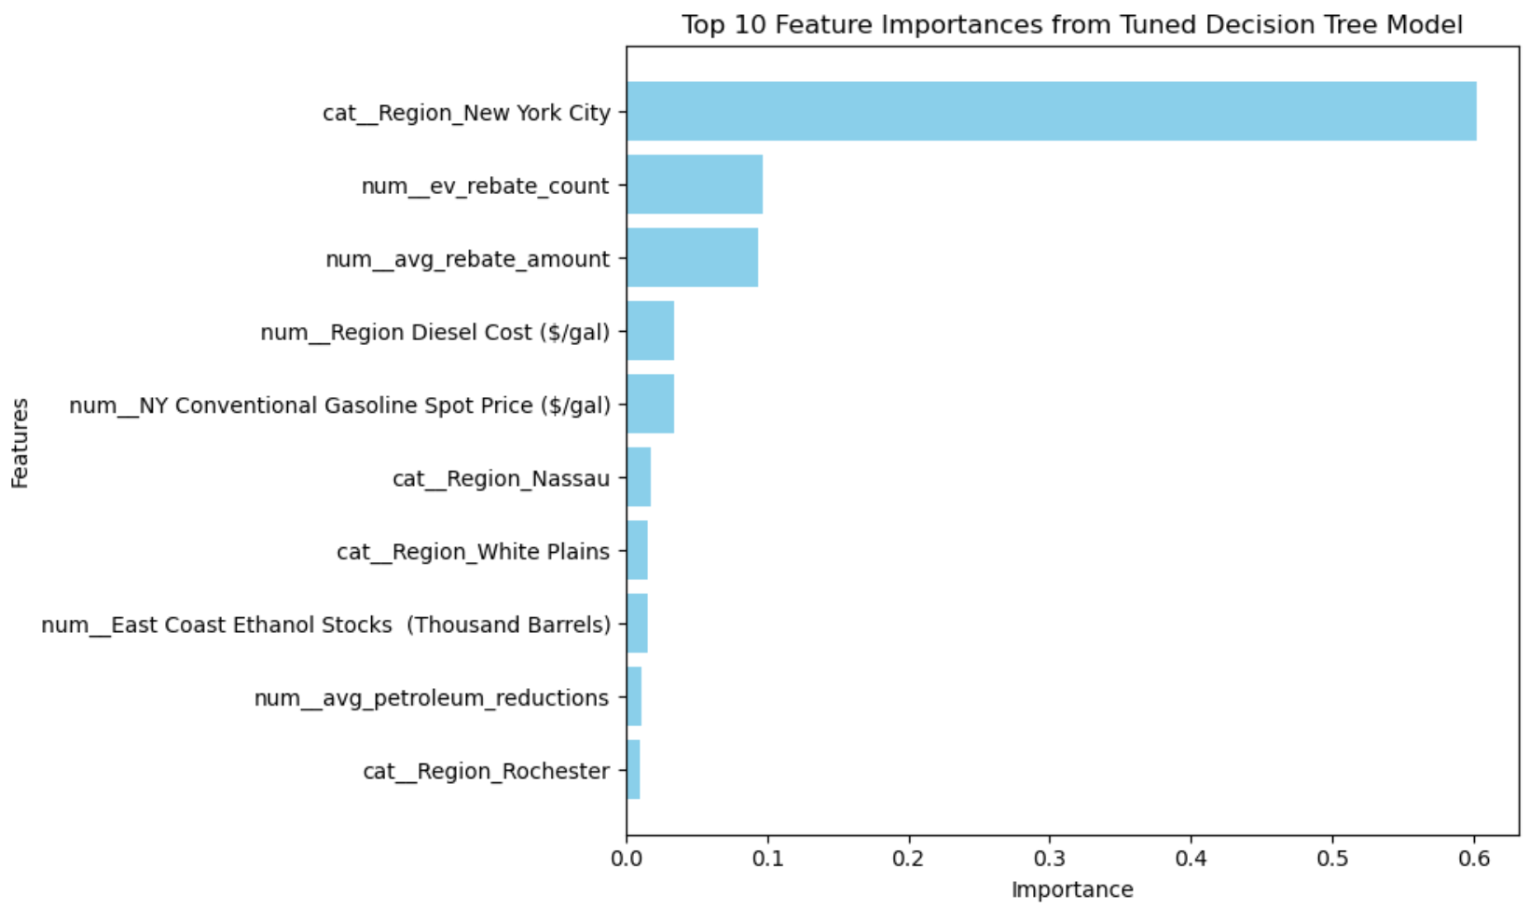
Decision Tree
Region_New York City:
As most important feature, this region plays a critical role in predicting EV registrations
ev_rebate_count & avg_rebate_amount:
The number of EV rebates and $ amount in rebates redeemed are highly influential predictors
Financial incentives have a significant impact on EV adoption.
num__Region_Diesel Cost ($/gal) & num__Region_Gas Cost ($/gal):
Fuel prices strongly influence EV adoption, as higher fuel costs make EVs more attractive relative to traditional vehicles.

Slide 11
Random Forest
We can use alternative models to validate our findings and confirm the stability of feature rankings
Random Forest : An ensemble learning method that builds multiple decision trees and averages their predictions.
Each tree is trained on a random subset of the data and features
Reducing variance and improving generalization
Provides more robust predictions
Performance:
Mean Absolute Error (MAE): 806.96
Mean Squared Error (MSE): 3,052,400.56
R² Score: 0.90

Slide 12
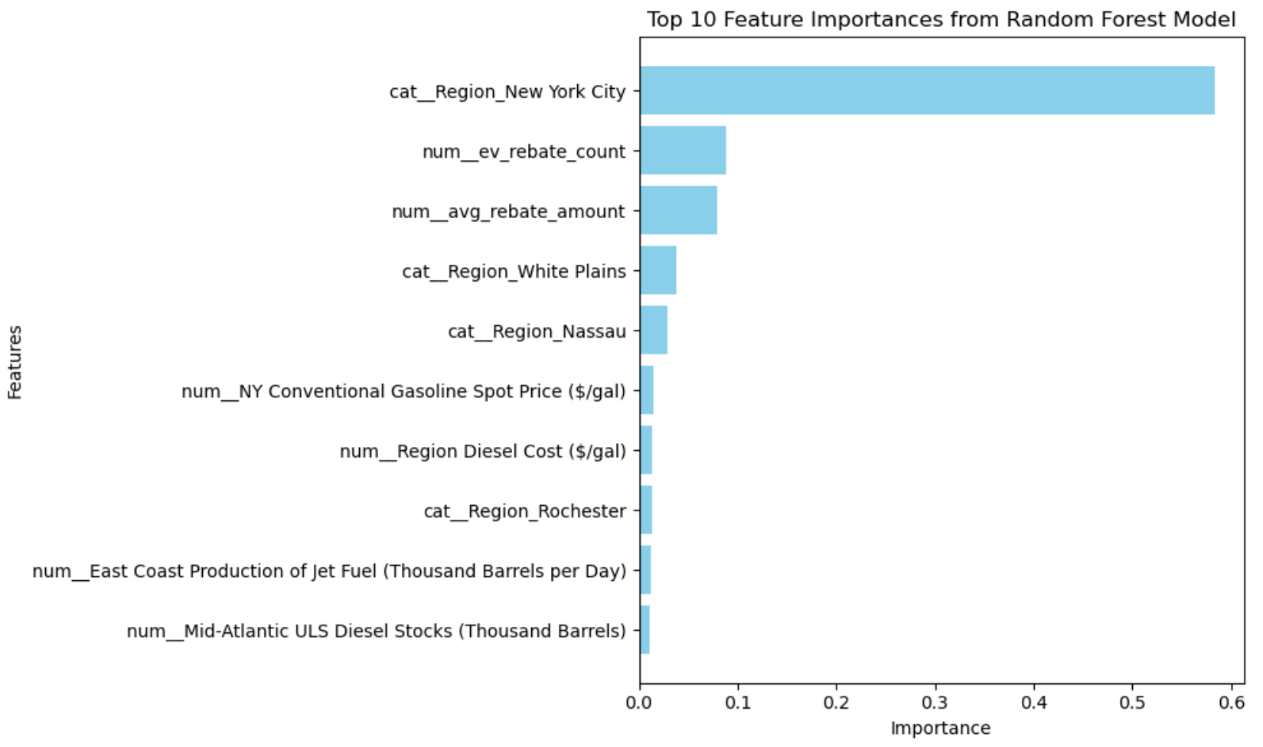
Random Forest
Consistency in Top Features:
Region_New York City remains dominant, validates its critical role in predicting EV registrations
ev_rebate_count & avg_rebate_amount continue to rank highly, underscoring the impact of economic incentives on EV adoption
Reduced Bias in Region-Specific Features:
Decision Trees could be biased towards one region (due to unbalanced data)
Random Forest provides a more balanced view by distributing importance across regions like cat__Region_White Plains, cat__Region_Nassau, and cat__Region_Rochester
The stability of high-ranking features between models suggests the robustness of the insights derived.

Slide 13
Neural Network
Model inspired by the human brain, designed to recognize patterns in data.
Processes inputs through layers of interconnected neurons to predict a target variable.
Captures Complexity: Handles intricate, non-linear relationships in data better than simpler models like Linear Regression
Adaptable: Excels with large datasets and diverse feature types.
Improves with Tuning: Can achieve better performance through hyperparameter optimization.
Challenge: Functions as a black box; tools like SHAP or LIME are needed for interpretability
Performance:
Mean Absolute Error (MAE): 703.14
Mean Squared Error (MSE): 1605178.77
R² Score: 0.95

Slide 14
Insights for Action and Path Forward
Focus on High-Potential Regions:
Prioritize incentives (e.g., rebates, tax breaks) and infrastructure development in regions like New York City, White Plains, and Nassau.
Data-Driven Customization:
Leverage predictive insights to align products, services, and infrastructure investments with regional needs and demands.
Future Work:
Further refine the current models to improve predictive accuracy and interpretability.
Incorporating Additional Data:
Socioeconomic data: Median income, education levels.
Experimenting with More Advanced Models:
Gradient Boosting Methods, Deep Learning Models: For time-series predictions and capturing complex patterns.

Slide 15
Future Work
Future Work
Incorporate additional datasets, such as:
Socioeconomic data (e.g., median income, education levels).
Vehicle lifecycle data (e.g., total EV fleet size).
Experiment with advanced models:
Gradient boosting methods (e.g., XGBoost, LightGBM).
Deep learning techniques for time-series predictions.
Explore time-series clustering to analyze temporal EV adoption trends.

